Slide 1
CowChips4Charity
Team (roles)
Brandon Bui (Admin Panel Dev)
Justin Lee (Admin Panel Team Lead)
Dustin Schultz (Test Engineer)
Lizzy Li (Game Dev)
Ty Bartleson (Game Team Lead)
Meghna Vaidya (Project Manager)
Client Ken Johnson
Advisor Lotfi Ben-Othmane
Notes:
Meghna

Slide 2
Project Plan

Slide 3
Project Vision Statement
Boo Radley Foundation
At halftime college football games, participants at the game will have the chance to play cow patty bingo
The event currently uses a real cow
The Boo Radley Foundation contributes to the funding of the research for common diseases shared between humans and household pets and finding better cures and treatments.
The stakeholders involved should include those who support the cause.
Our project includes two components:
Admin panel
Interactive web application game
Notes:
Lizzy
Our project, called CowChips4Charity, is intended to fundraise for the Boo Radley Foundation. At halftime college football games, participants at the game will have the chance to play cow patty bingo by donating. In the past, CowChips4Charity had a real cow in a field demonstrating this, but to cut costs and time, it was decided by the foundation that a web application simulating these events would be more beneficial.
The Boo Radley Foundation contributes to the funding of the research for common diseases shared between humans and household pets and using the research results to find better cures and treatments. The stakeholders involved should include those who support the cause.
Our project includes two components: an admin panel that utilizes data visualization libraries that allows admin users to view any analytical data about the simulated games that have been played, and an interactive web application game that allows users to play the game and donate.

Slide 4
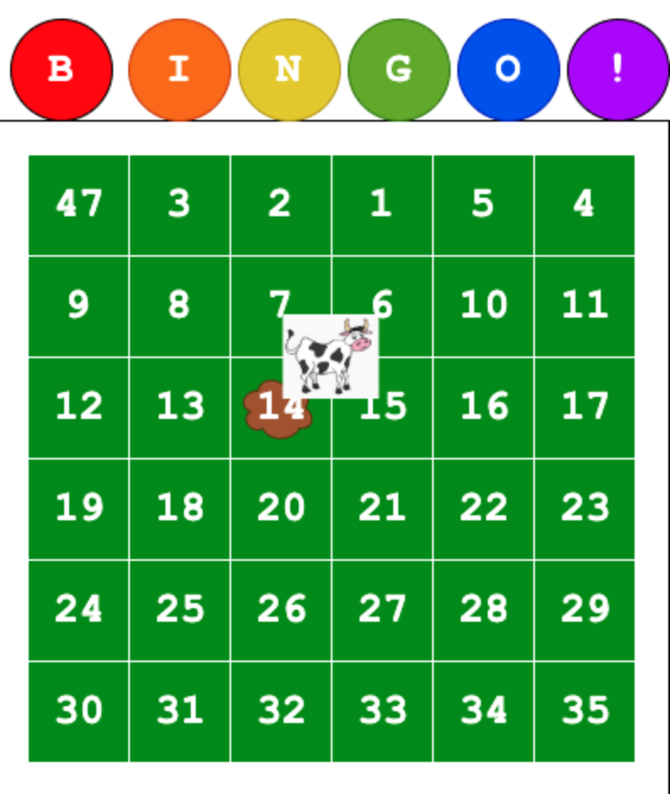
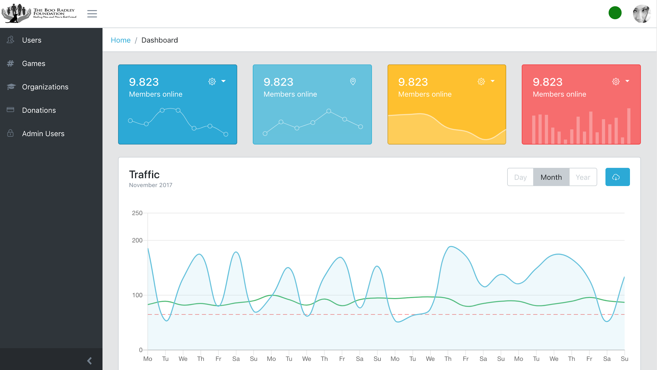
Conceptual/Visual Sketch
Notes:
Lizzy
Currently the game isn’t implemented yet, but here is a rough idea of what our client and ourselves have agreed on on the left. The bingo game shall consist of a 6x6 grid and our client requested an animation for the cow to drop a chip onto the square. Those who donate shall purchase a square and whichever square contains the chip will win.
And on the right, we have a conceptual sketch of what we would imagine viewing the data analytics on our game panel to look like, as it is currently not implemented.

Slide 5
Functional Requirements
The User shall be able to choose a square(s) depending on how many squares they bought
The User shall be able to choose which game to watch
The User shall be able to watch the game live
The Game shall be able to choose an unbiased square for every game
The Game shall inform which square won
Multiple games should be able to be run at once
Game time should last between 5-10 minutes
Game should have a limit to how late a user can choose a square(s)
The Admin shall be able to see various data in the data panel (donations per game, the number of people who donated, donations per team, etc.)
Notes:
Bui
Earlier in the semester shortly after we were assigned the project and met with the client, we met as a group to brainstorm some requirements. Here on the screen are the ones we established as the functional requirements of project. We came up with functional requirements for the user, the game and the admin panel. After talking with our client, it seemed like having a functional game was the most important part of this project. That’s why over half of our requirements relate to having a functional game, for the users to play and for the admin to collect data from.

Slide 6
Non-Functional Requirements
The Website shall look aesthetically pleasing
The Website should be able to work on any device in any browser
Security
The entire credit card transaction information will be encrypted
Usability
The user shall be able to complete the transaction in one page of the web app
Performance
The application shall be able to support scalability for multiple football game users
The user shall be able to login to his/her account in less than 15 seconds
The winning user shall receive a notification within 12 seconds of the cow finishing
The web app shall be able to calculate the entire cost of the donation once the user is checking out within 3 seconds
Reliability
The application shall have 100% runtime during football games
At least 1000 users will be able to use the web app as it is designed to work
Operational
The web app will be compliant with all policies and regulations set forth by the Boo Radley Foundation
Notes:
Bui
We brainstormed our non-functional requirements and functional requirements in the same meeting. Here on the screen are the non-functional requirements we agreed on as a team. We split most of them up into 5 types, Security, Usability, Performance, Reliability, and Operational. When we decided on the non-functional requirements, we also decided on the 5 types of non-functional requirements we wanted to use. Our team also added 2 requirements about the website because after meeting with our client it seemed very important to him. After we came up with all our requirements we presented them to our client for approval

Slide 7
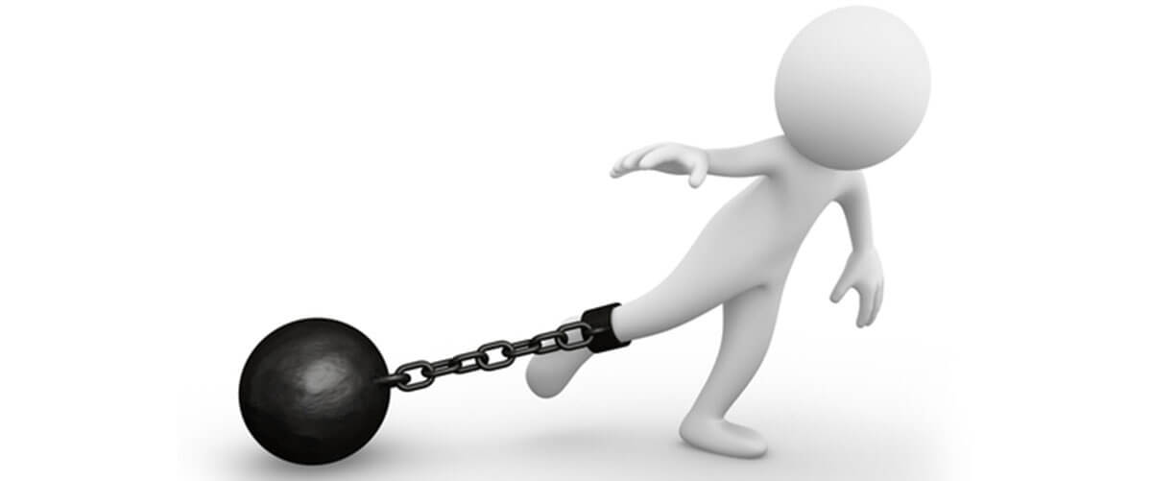
Technical Constraints/Considerations
Previous team used Node.js and Vue.js
Receiving the previous team’s code
Notes:
Bui
We had 2 technical constraints as a team. One constraint was that the previous team used node.js and vue.js therefore we used node.js and vue.js to work around this constraint. The biggest constraint we had was receiving the previous team’s code. It took us a while to get the code from the client and once we got it we were missing multiple files that we needed. We have gotten most of the missing files from the client and hopefully will have all them them soon.

Slide 8
Market Survey
It is a very unique and specific product
Needs assessment:
This game is supposed to reduce time and effort for our client
It has to appeal to our client’s potential partners (colleges)
As well as the people at football games
Priority is the animated game
Notes:
Meghna

Slide 9
Potential Risks & Mitigation
Risks:
Teams collective knowledge of technologies
Vue.js, Node.js, Express
Heroku, mLab, AWS, and Stripe
Adapting to previous teams code
Need to understand their structure and development
Mitigation:
Will require all members to take the time to learn what each one is and what it does in terms of our project
Spend extensive hours setting up their code and going through to make sure everything works from their project to be able to build on it
Notes:
Meghna

Slide 10
Project Milestones & Schedule
Notes:
Dustin

Slide 11
System Design
Notes:
Dustin

Slide 12
Functional Decomposition
Game
Update UI
Implement Game
Add animations
Create assets
Responsive to backend data
Admin
Add analytics
Add data visualization
Support real-time data
Notes:
Dustin

Slide 13
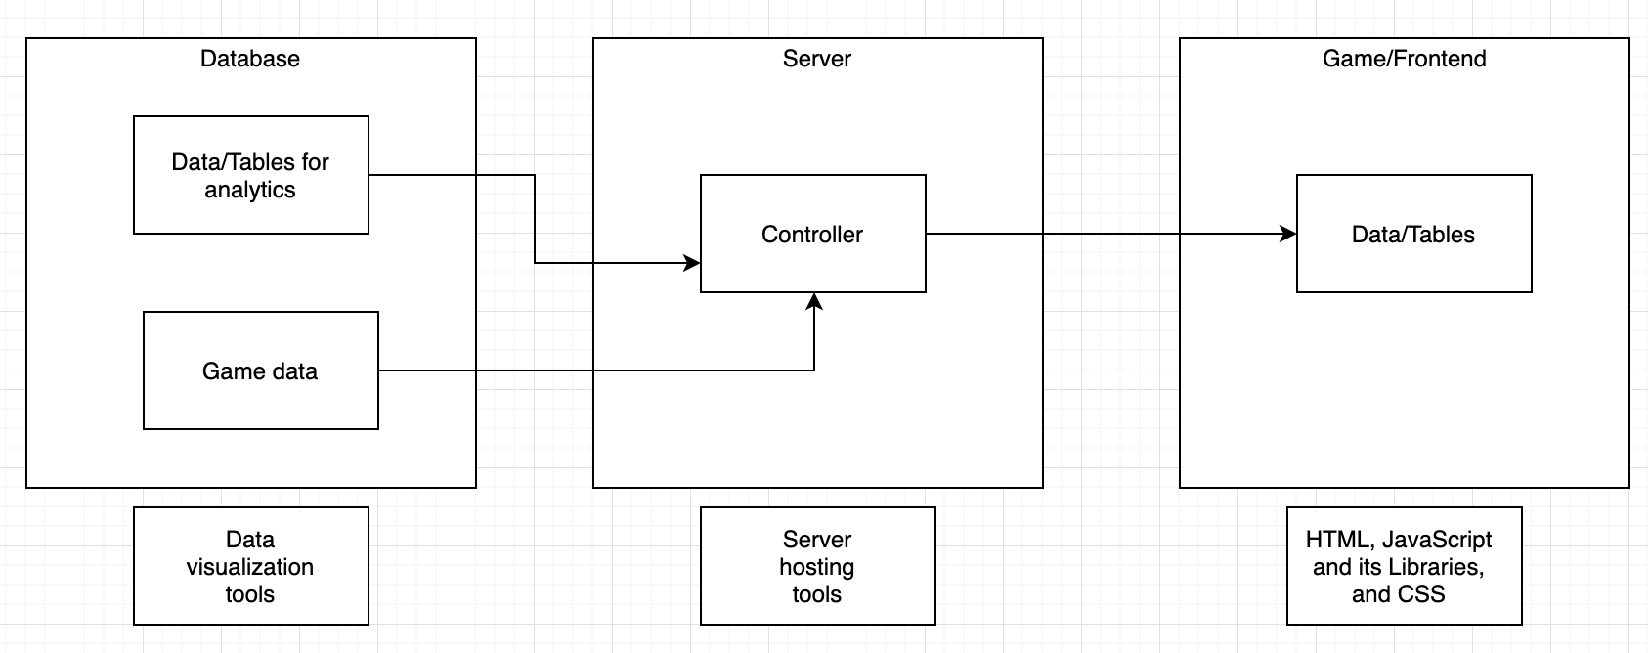
Conceptual Design Diagram
Notes:
Justin Lee

Slide 14
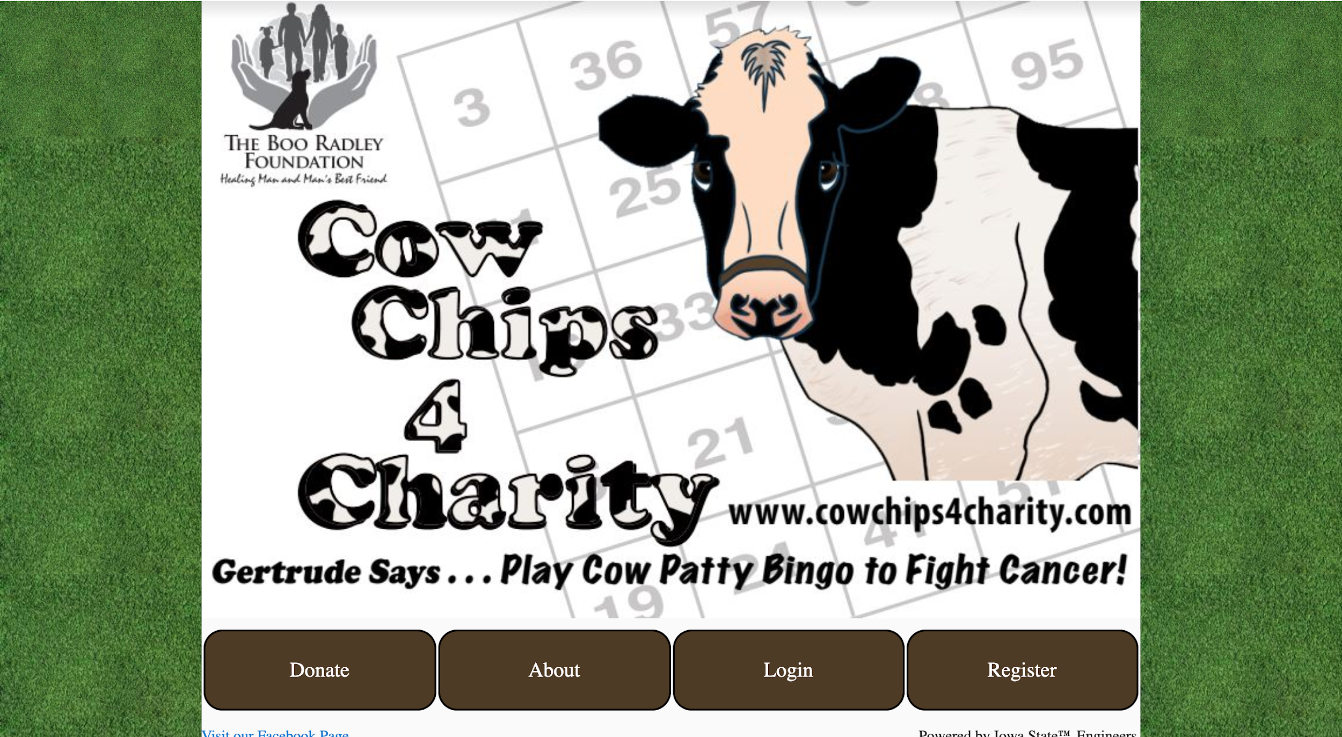
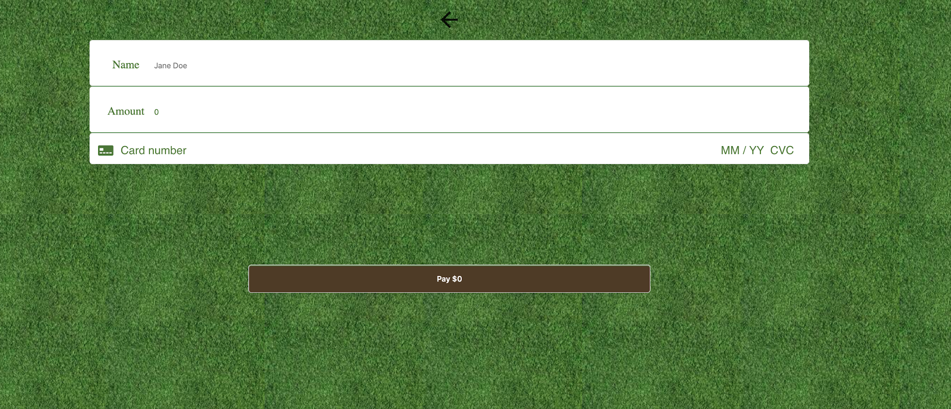
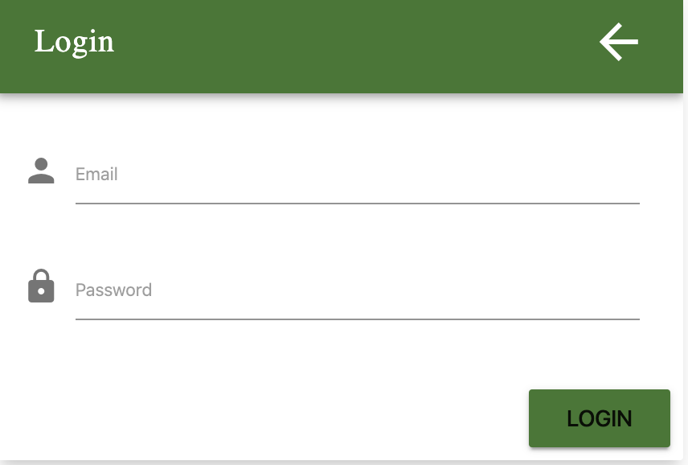
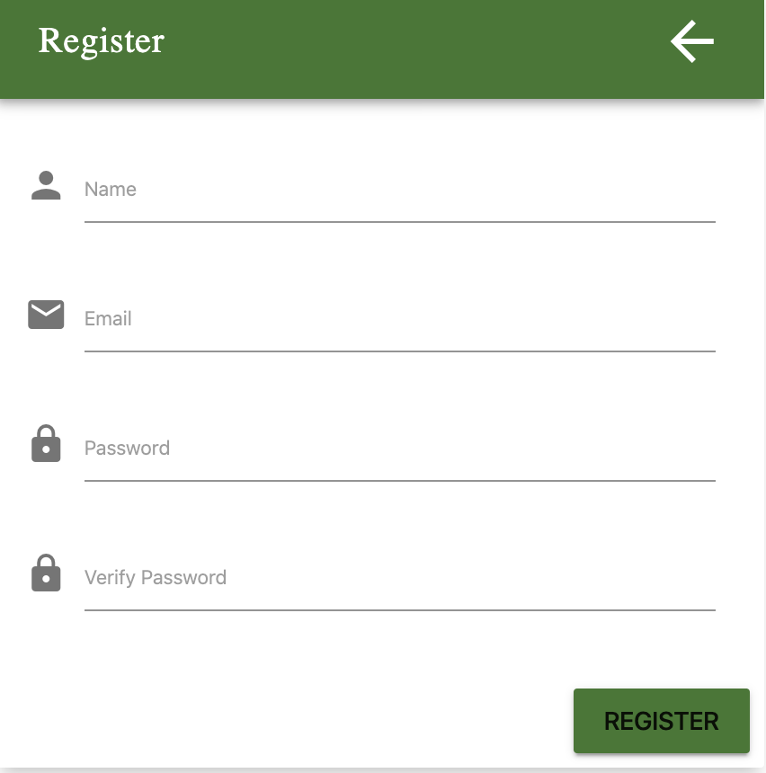
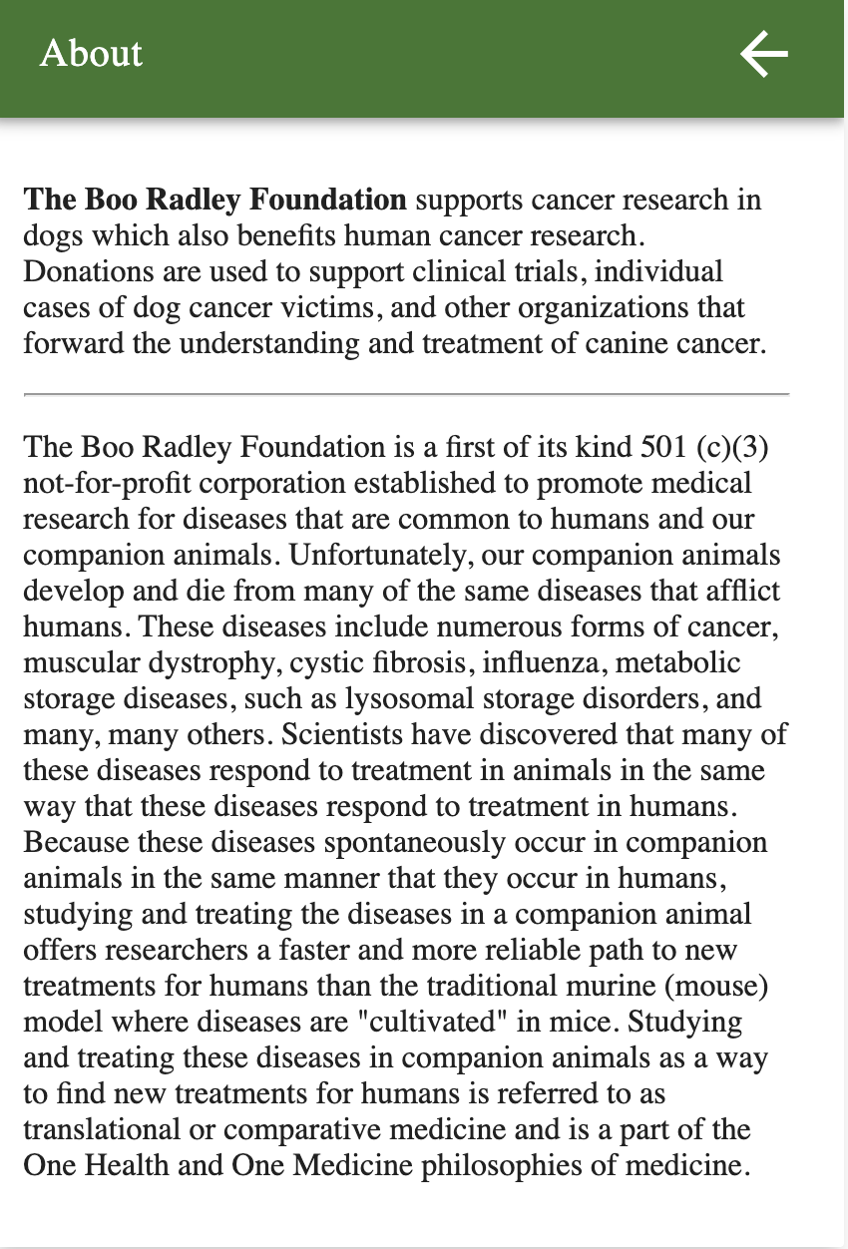
UI/UX
Notes:
Lizzy
So this is what we have so far for our game side of the project. Currently you can login, register, view the about page, and donate. Our website should be easy to figure out how to navigate by anyone planning to donate and play the game, as the clientele consists of anyone who plans on playing the game and/or donating to the cause.

Slide 15
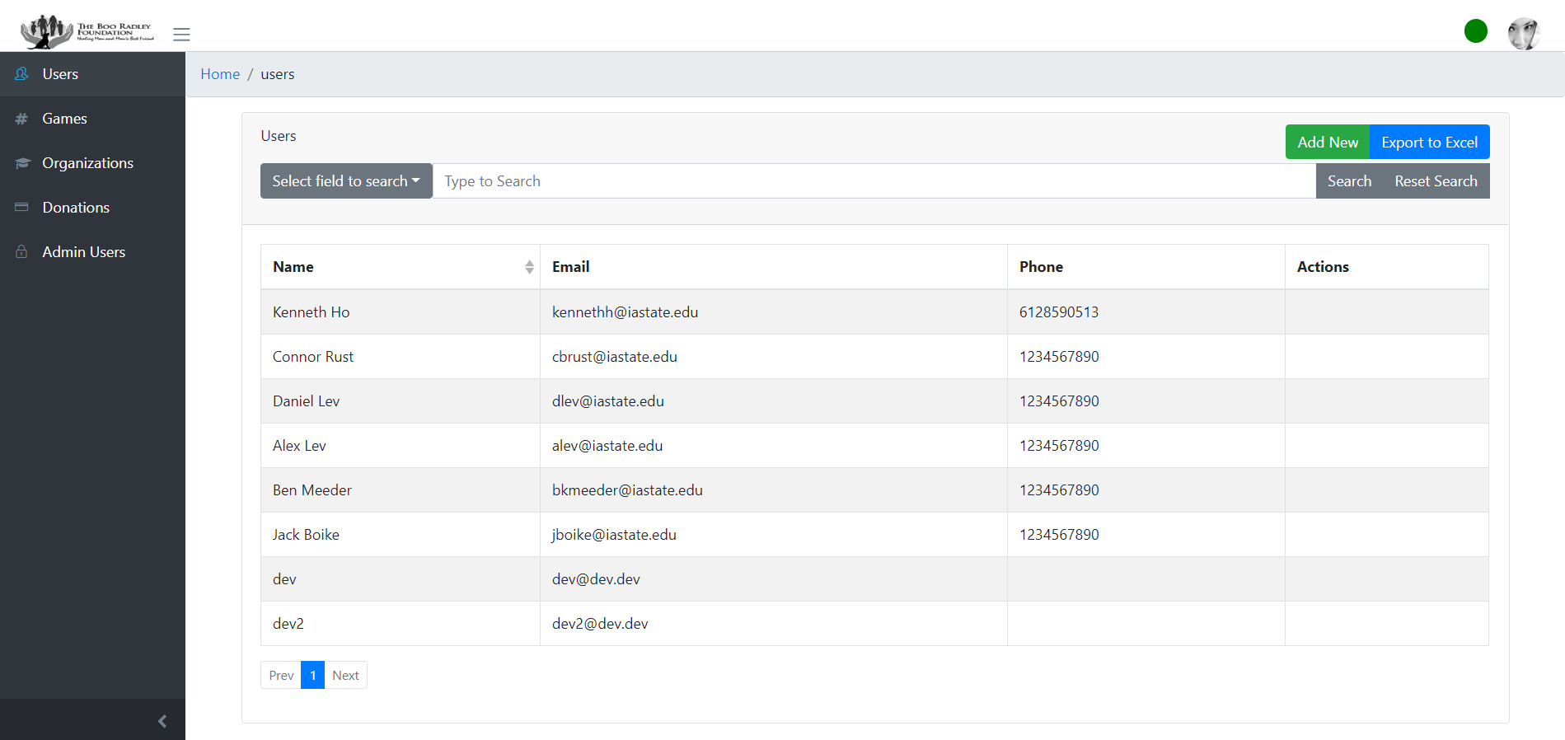
UI/UX
Notes:
Lizzy
We have our admin panel where the registered users and their contact information can be seen. You can view their name, email, phone. The actions column allows admin to edit the game board, edit organizations list, select winning tile, edit game information, and remove game from database. In the future, we will add navigation to analytics in the same column and view winners.

Slide 16
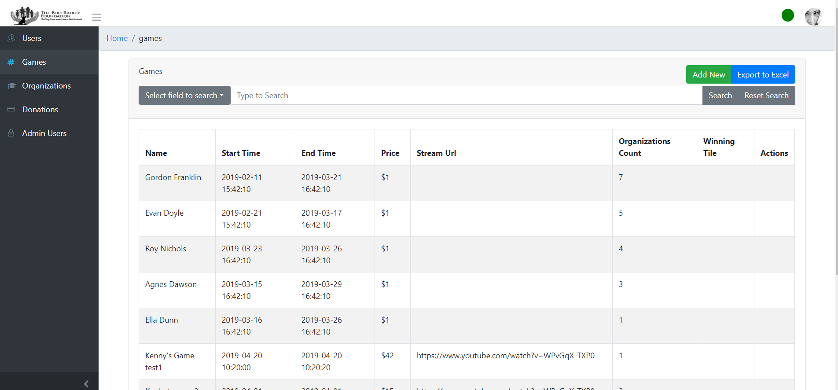
UI/UX
Notes:
Lizzy
We can view the games and the organizations by viewing name, start and end time, the donations, the url to streaming the game, the amount of participants, winning tile, and another actions column

Slide 17
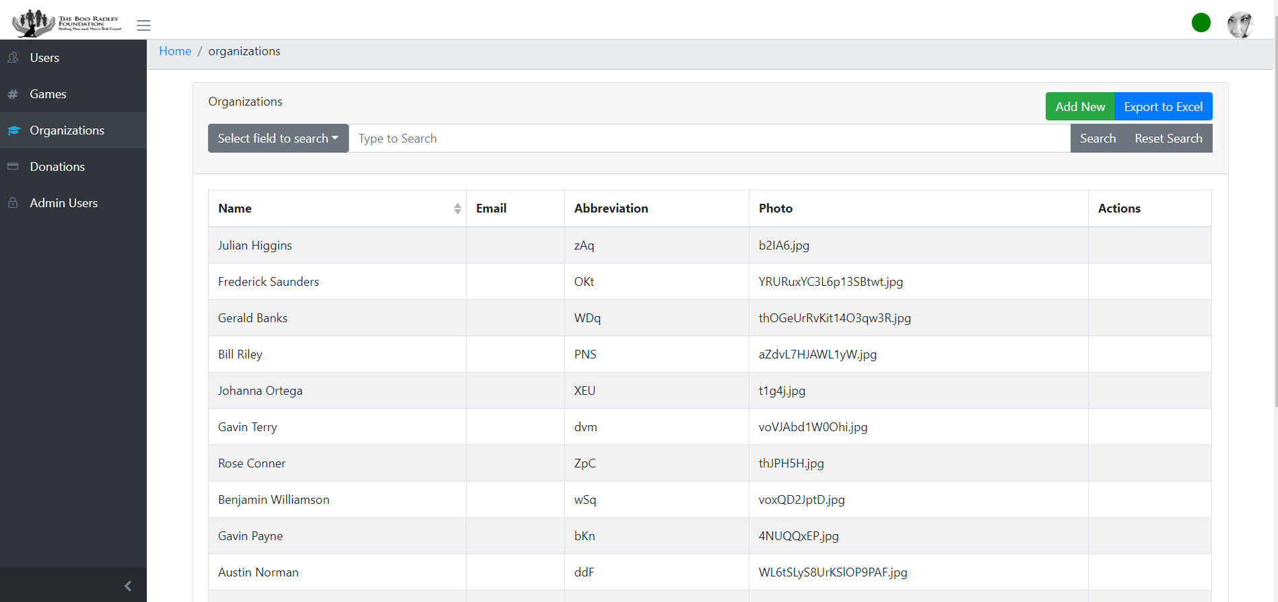
UI/UX
Notes:
We can view different schools that have participated in the games, including their point of contact, abbreviation for the school, an image of the school for reference, and actions once again.

Slide 18
Technology Platforms
Front End: Vue.js
Back End: Node.js/Express
Database: Mongodb
Hosting: Heroku
Notes:
Justin Lee

Slide 19
Test Plan
Test Driven Development
CI/CD Pipeline automatically runs tests - powered by Travis CI
Jest plugin for Travis CI to run backend testing
Unit and Component testing
Cypress plugin for Travis CI to run frontend testing (similar to Selenium)
Interface testing
Predefined use case scripts performed manually
System testing and Acceptance testing
Notes:
Dustin

Slide 20
Conclusion

Slide 21
Current Project Status
Project fully designed
Became familiar with previous team’s documentation and code
Updated Current User Interface for the Game Website
Tyler: Home page
Elizabeth: Donation page
Meghna: Login, Register, and About pages
Tested with Various tools for Data Analysis
Deepstream.io
Core UI
Updated Documentation for Transitioning
Notes:
Ty

Slide 22
Plan for Next Semester
Game Team:
Begin coding the digital version of the game
Add the game to the website
Test the game
Help connect game to the admin panel
Admin Panel Team:
Finish implementing real-time analytics
Add data visualization
Notes:
Ty

Slide 23
Questions?

